Slide 1
Vector Genetics in the DTK Scenarios

Slide 2
Scenarios
Name | Description
SingleEffector | Release of an effector component at a single genetic locus (no driver)
SingleDriver | Release of a drive component at a single genetic locus
DriverAndEffector | Co-release of both a drive, and effector component, using a different locus for the effector component
DriverAndTwoEffectors | Co-release of both a drive, and two effector components (using different locus for the effector components)
NonDrivingCas9 | Release of an effector component with a non-driving source of Cas9 (i.e. a source of Cas9 that is inherited at a Mendelian rate)
Resistance | Co-release of both a drive, and effector component into a brackground with pre-existing resistance alleles
DelayedRelease | Initial release of a single drive, and effector component, followed by delayed release of a second effector component
DriverAsEffector - Co-Release of both a drive and effector component
In DTK, this is the same as SingleDriver

Slide 3
Parameters Initial Distributions, Drivers, Releases
Alleles - Initial Distribution | SingleEffector | SingleDriver | DriverAndEffector | DriverAndTwoEffectors | NonDrivingCas9 | Resistance | DelayedRelease
Aw |  | 1 | 1 | 1 | 0 | 0.75 | 1
Ad |  | 0 | 0 | 0 | 0 | 0 | 0
Ar |  |  |  |  | 1 | 0.25 | 0
Bw | 1 |  | 1 | 1 | 1 | 1 | 1
Be | 0 |  | 0 | 0 | 0 | 0 | 0
Cw |  |  |  | 1 |  |  | 1
Ce |  |  |  | 0 |  |  | 0
Drivers
Aw |  | 0.3 | 0.3 | 0.3 | 0.3 | 0.3 | 0.1
Ad |  | 0.7 | 0.7 | 0.7 | 0.7 | 0.7 | 0.7
Ar |  |  |  |  |  |  | 0.2
Bw |  |  | 0.1 | 0.1 | 0.1 | 0.1 | 0.1
Be |  |  | 0.9 | 0.9 | 0.9 | 0.9 | 0.9
Cw |  |  |  | 0.2 |  |  | 0.2
Ce |  |  |  | 0.8 |  |  | 0.8
Release
Number | 10,000 | 1,000 | 1,000 | 1,000 | 10,000 | 1,000 | 1,000
A1 |  | Ad | Ad | Ad | Ad | Ad | Ad
A2 |  | Ad | Ad | Ad | Ad | Ad | Ad
B1 | Be |  | Be | Be | Be | Be | Be
B2 | Be |  | Be | Be | Be | Be | Be
C1 |  |  |  | Ce |  |  | Ce
C2 |  |  |  | Ce |  |  | Ce
Aw-Bw-Ce:Aw-Bw-Ce
Released at T-800

Slide 4
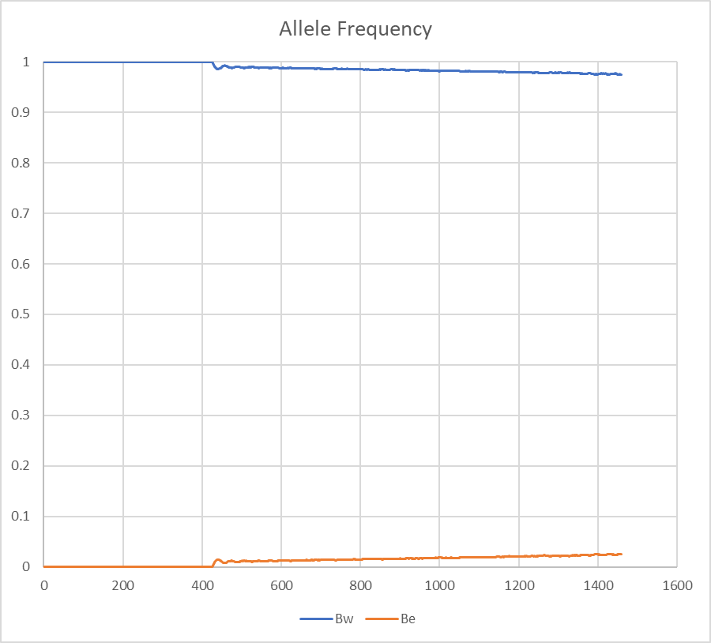
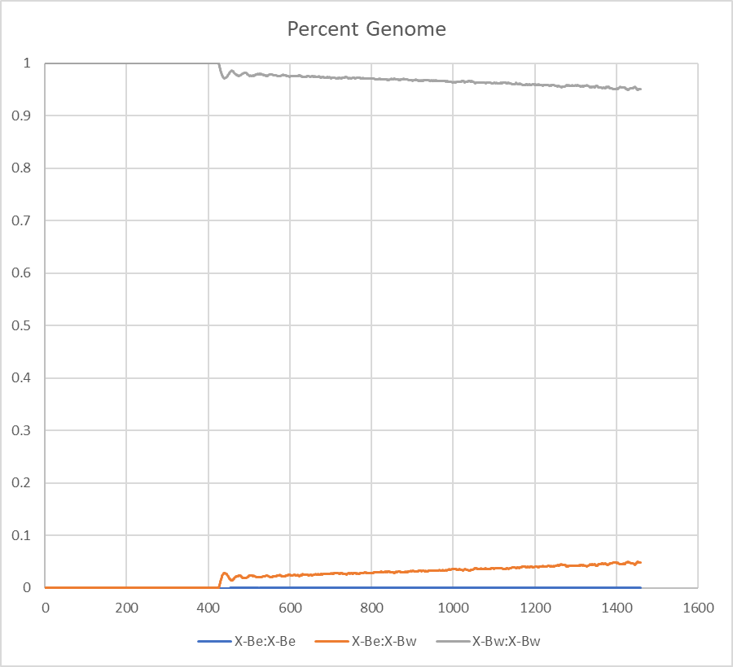
Single Effector

Slide 5
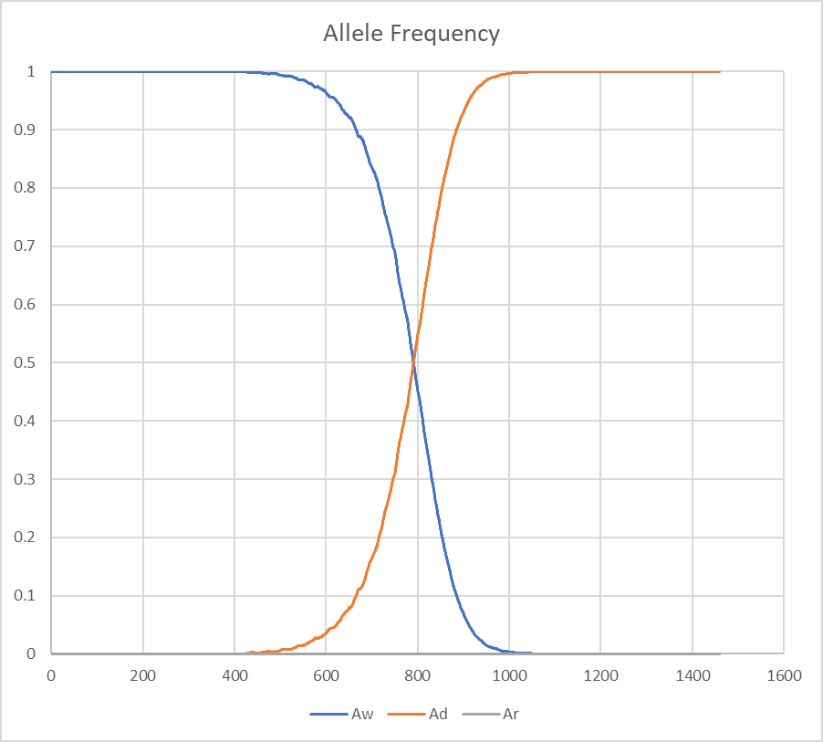
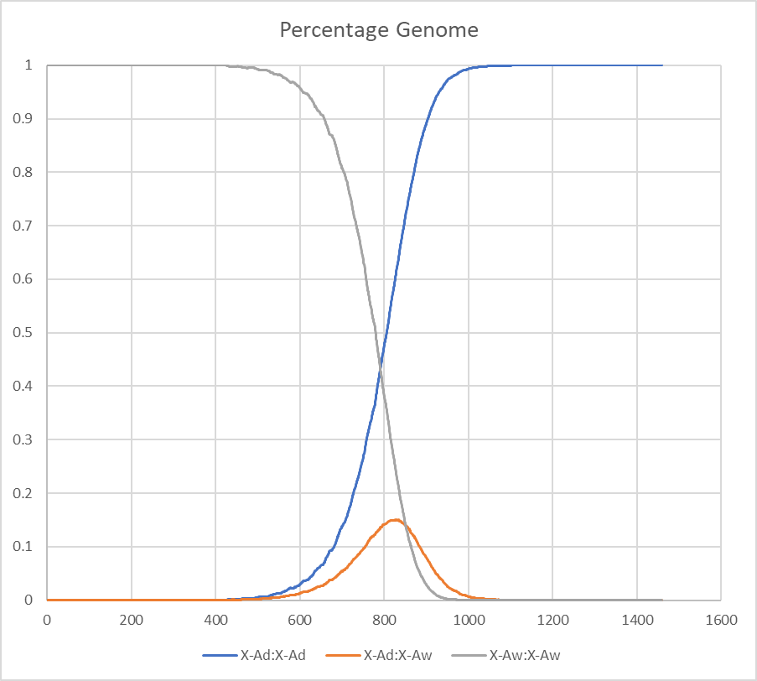
Single Driver

Slide 6
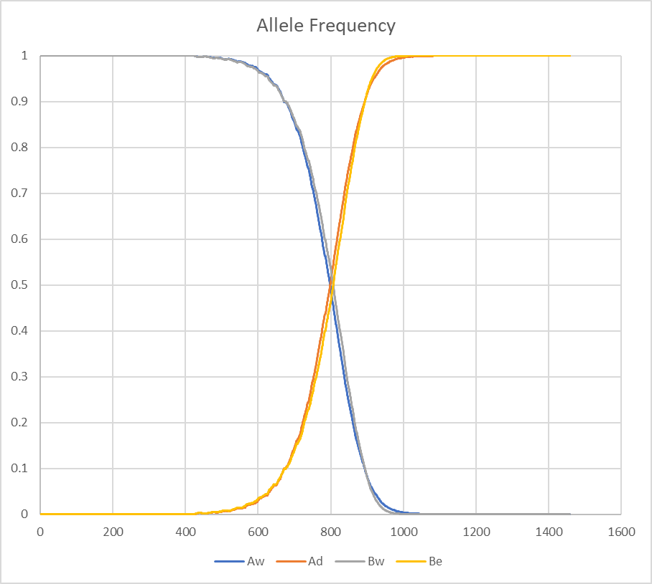
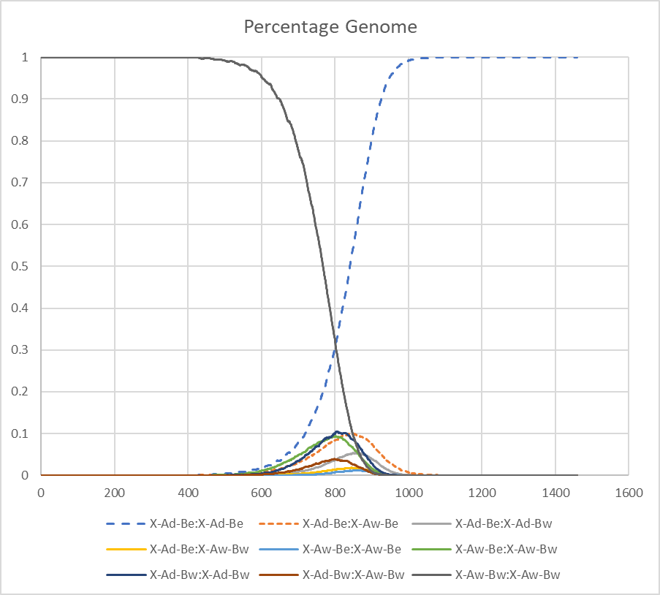
Driver and Effector

Slide 7
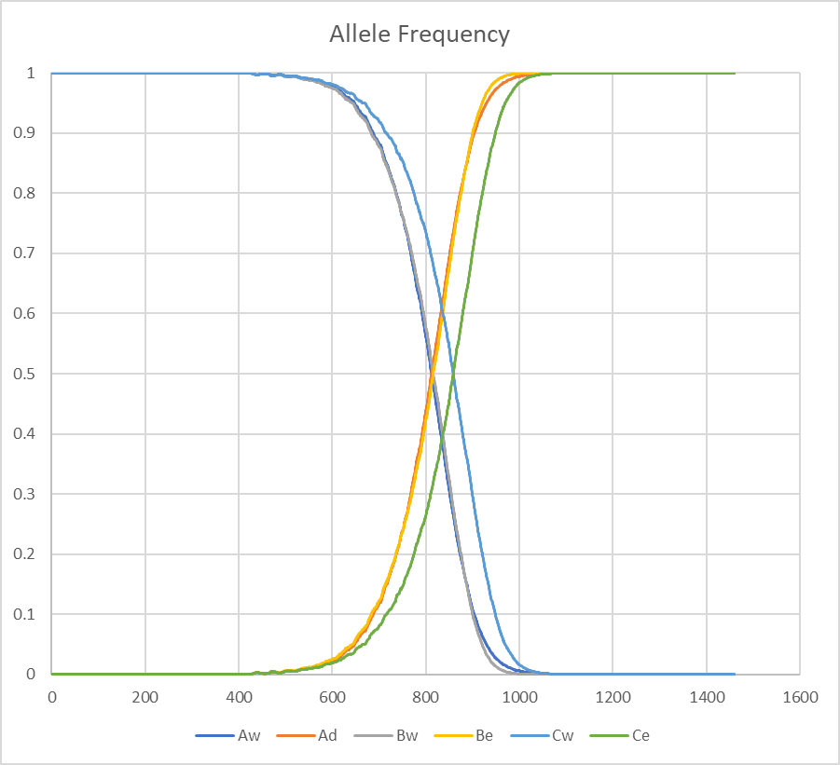
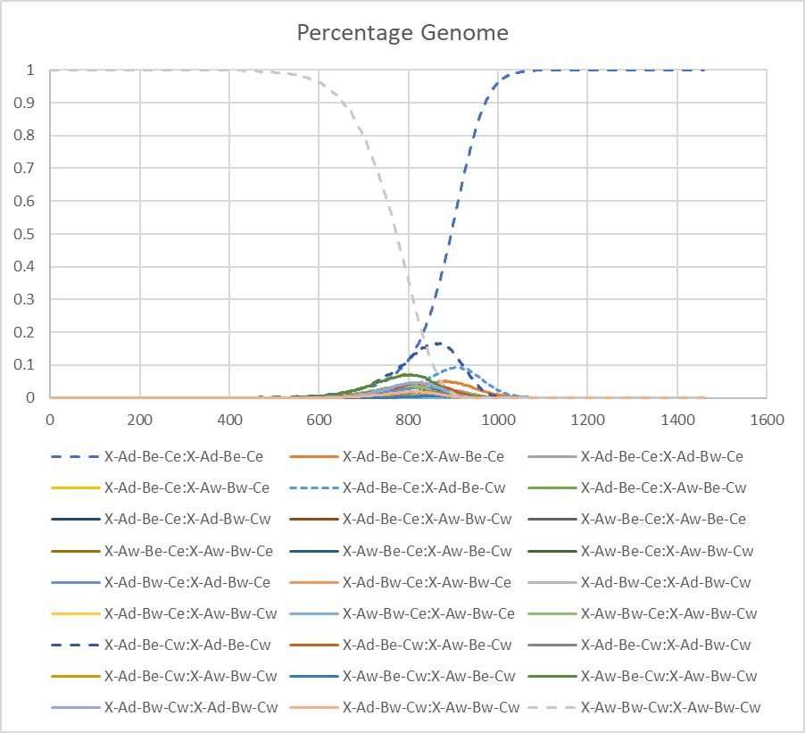
Driver and Two Effectors

Slide 8
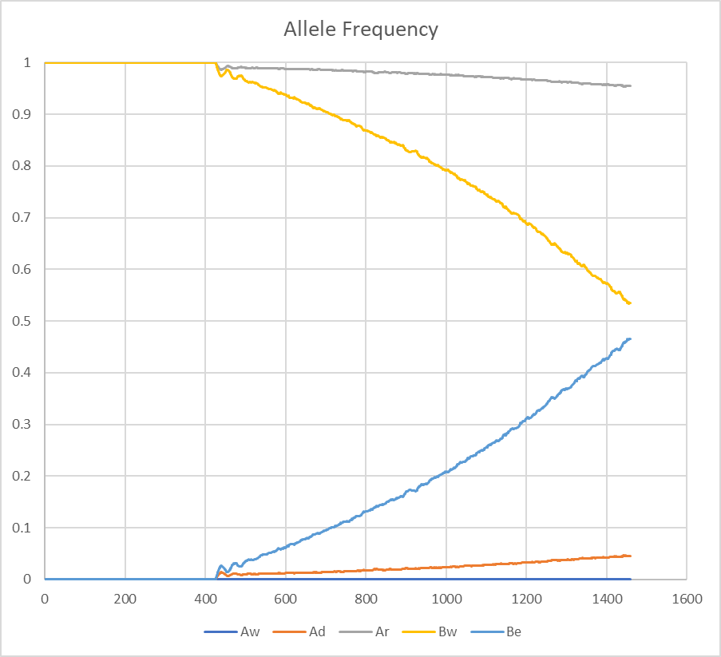
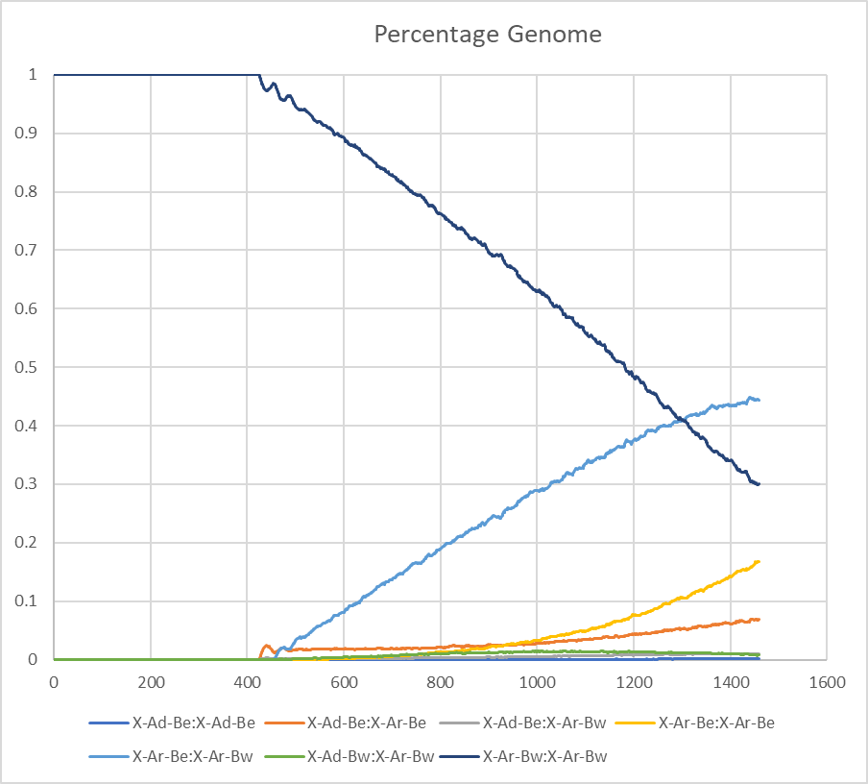
Non Driving Cas9

Slide 9
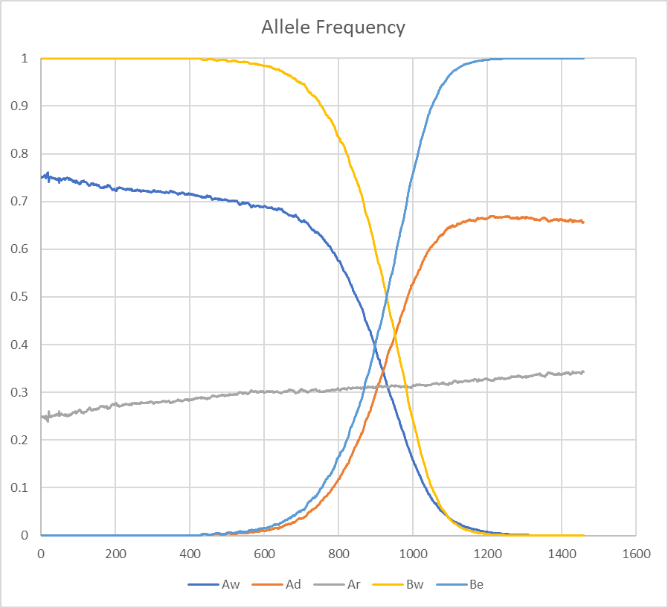
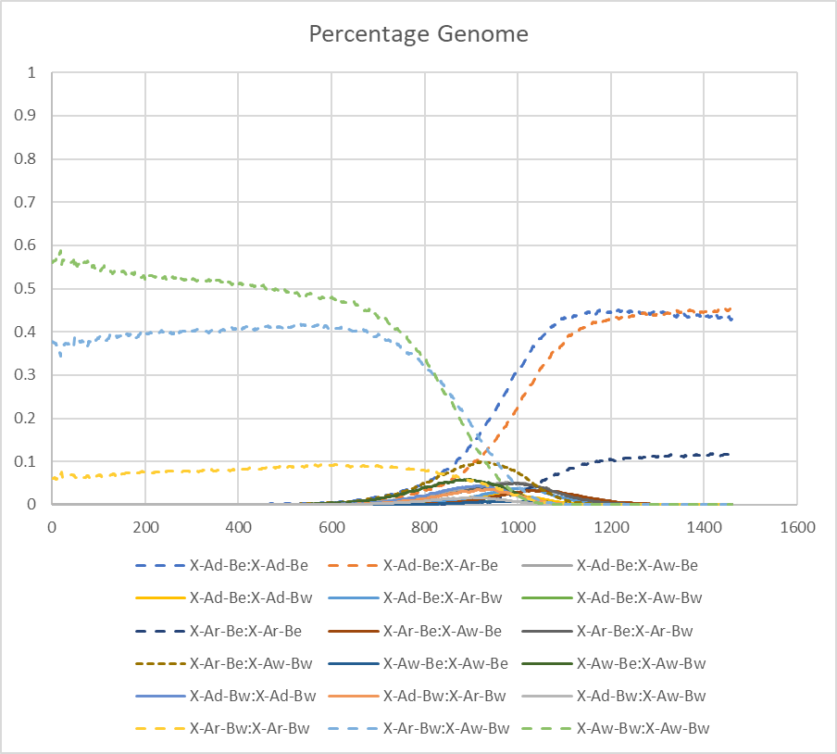
Resistance

Slide 10
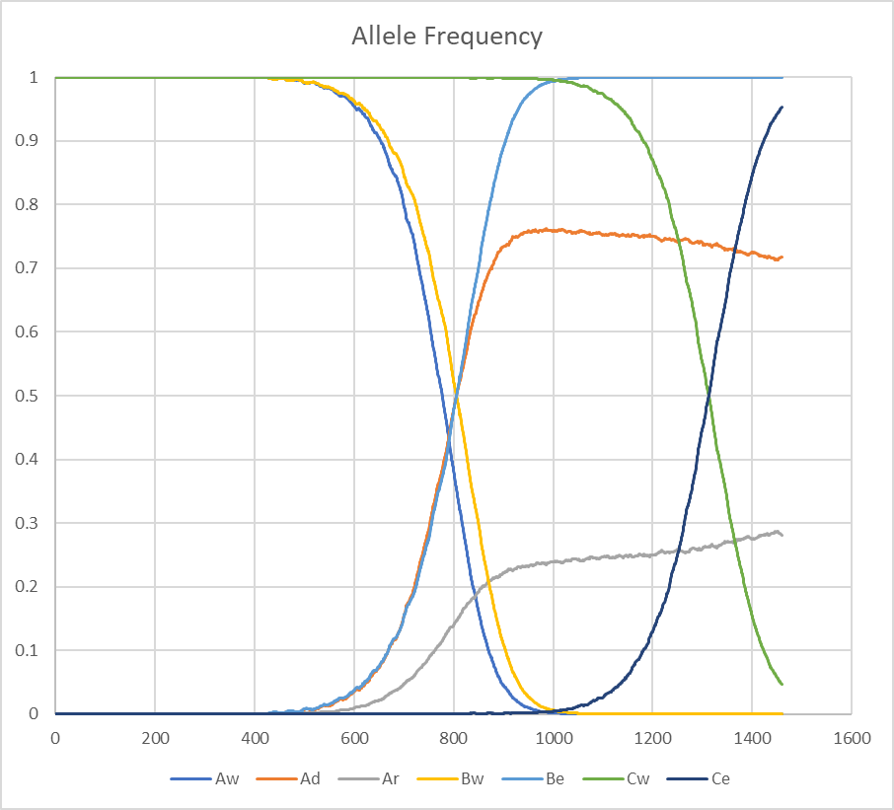
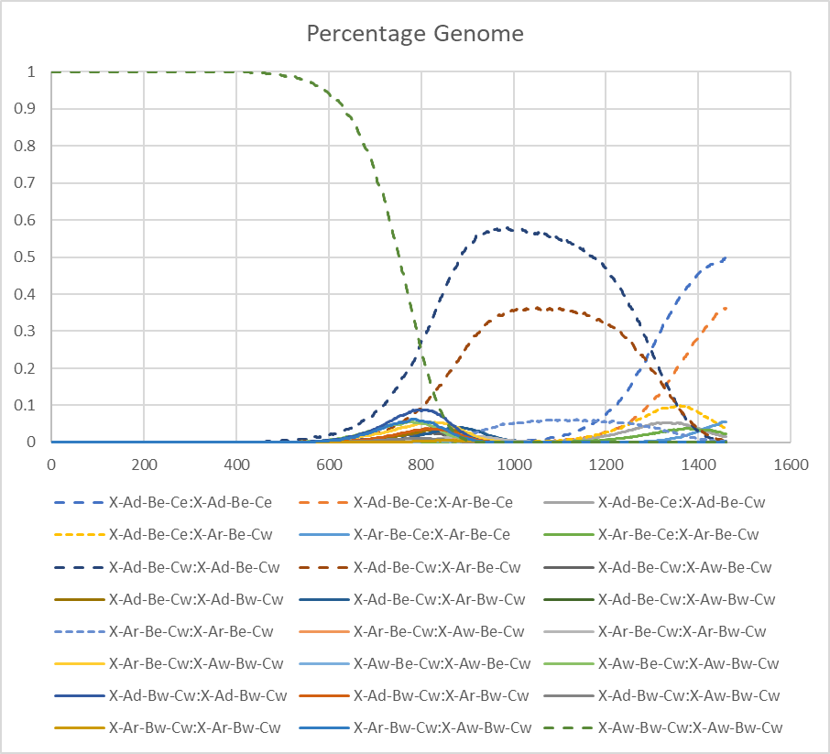
Delayed Release

Slide 12
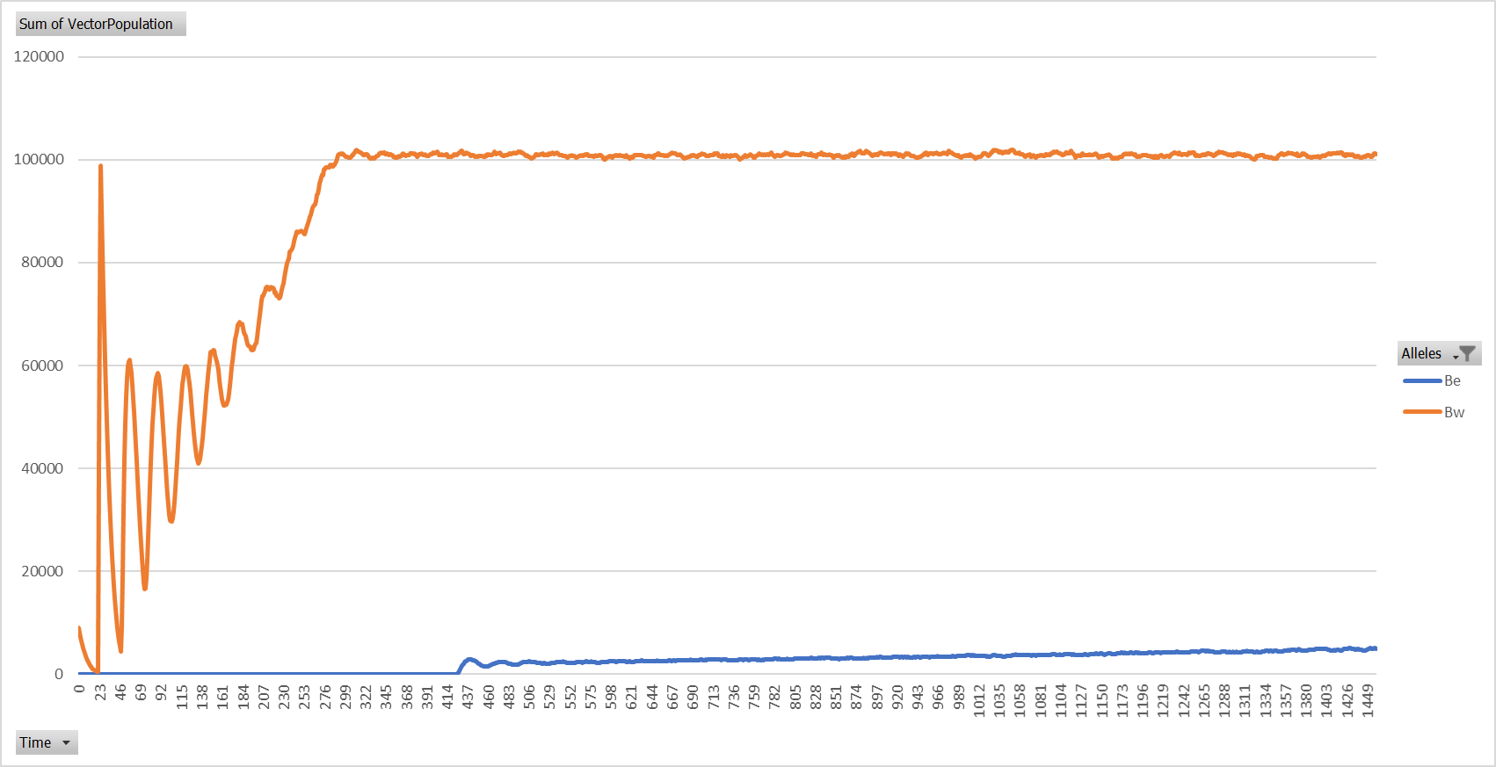
Single Effector

Slide 13
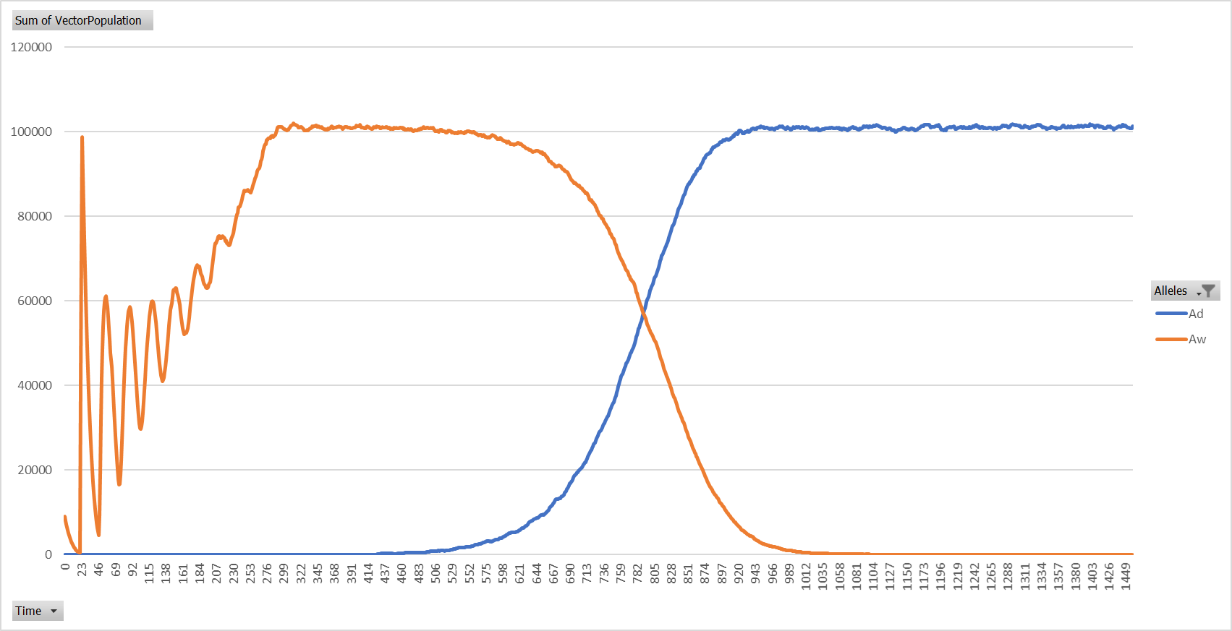
Single Driver

Slide 14
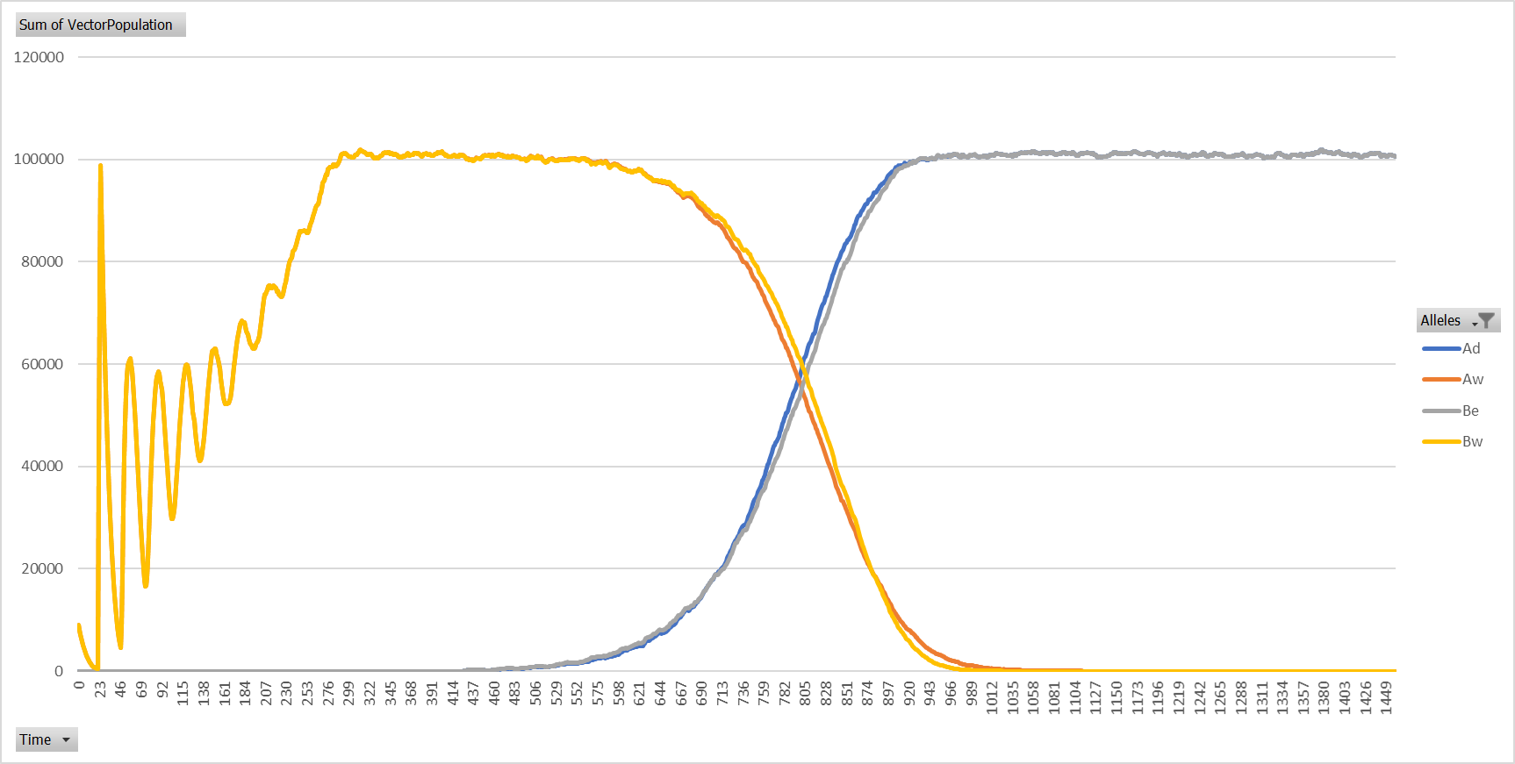
Driver And Effector

Slide 15
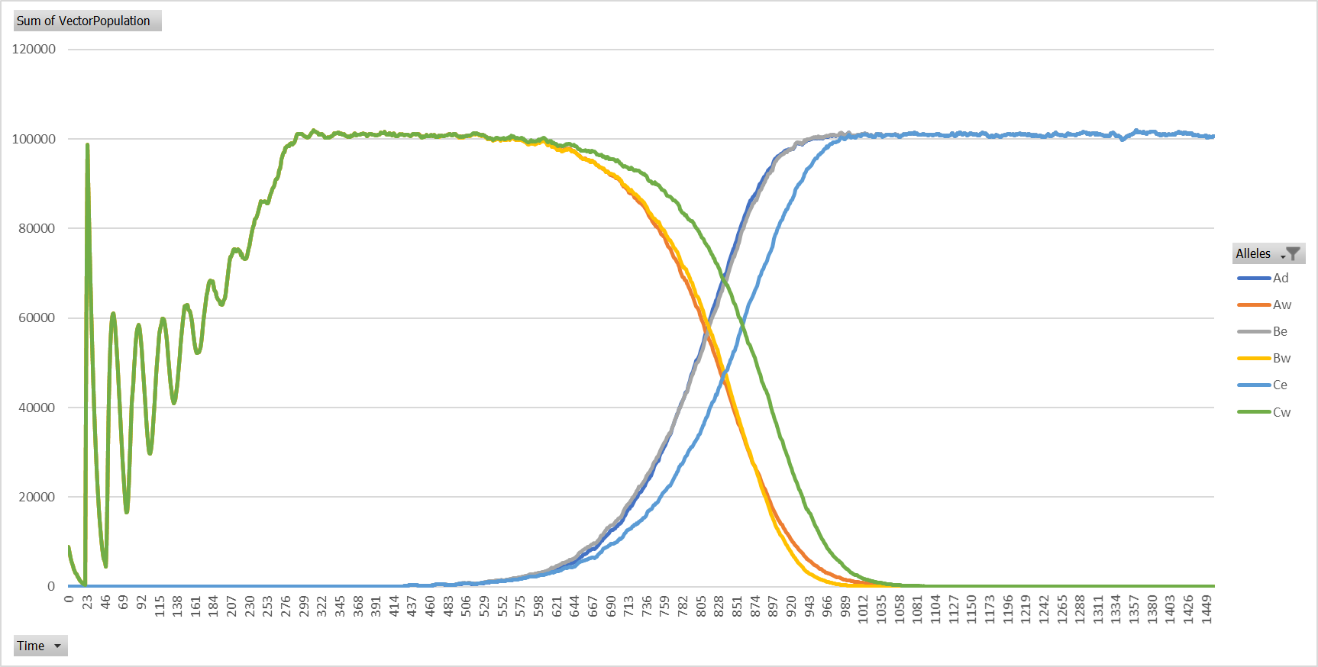
Driver and Two Effectors

Slide 16
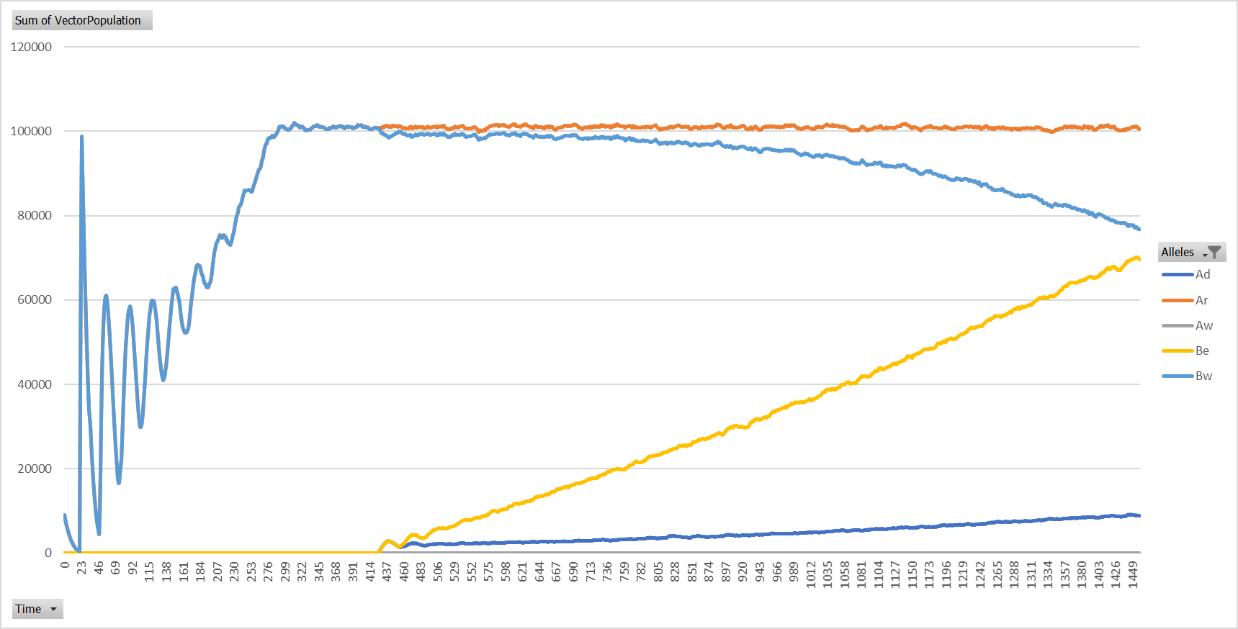
Non-Driving Cas9

Slide 17
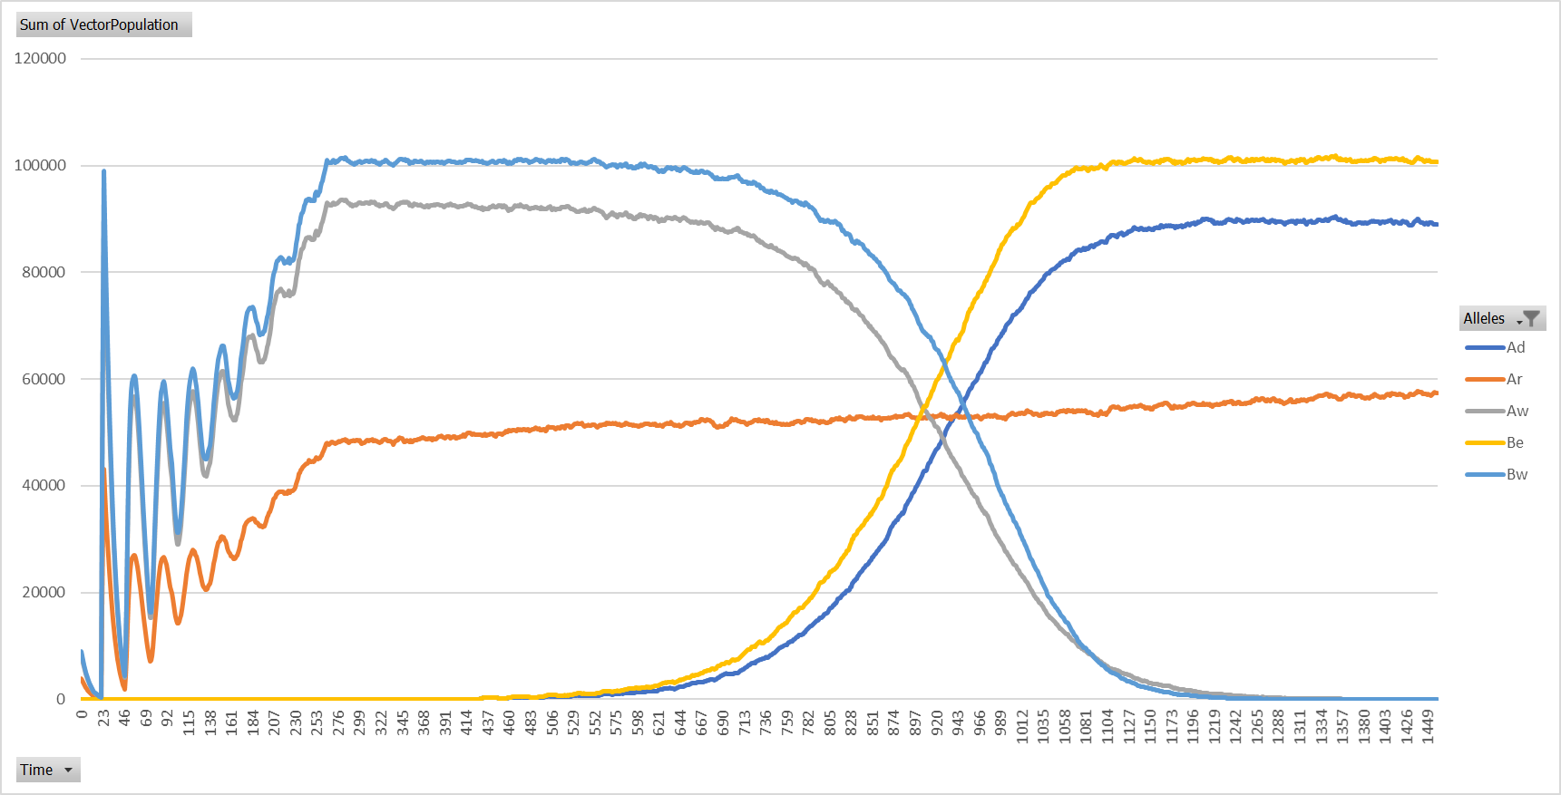
Resistance

Slide 18
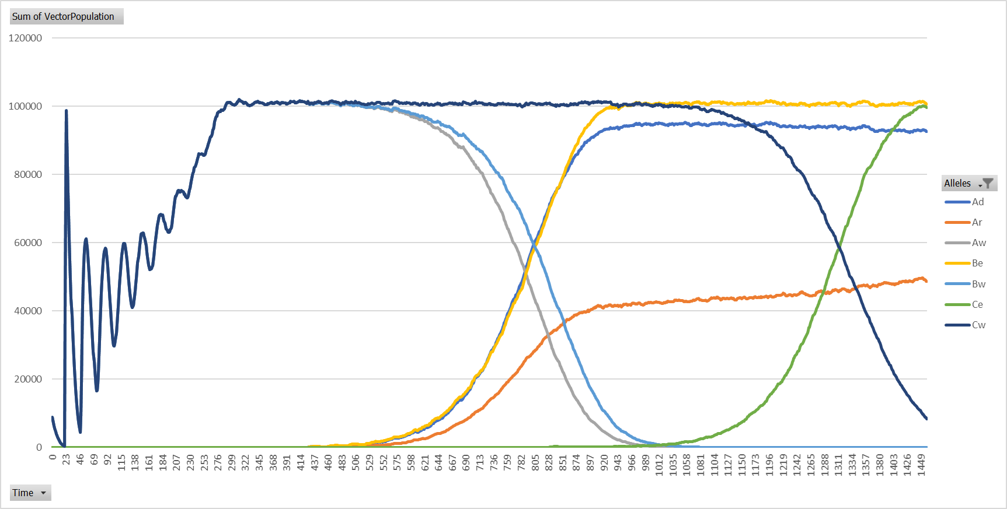
Delayed Release

